Slide 1

Pricing Excellence
We are the trusted advisor for developing M&A strategies and supporting our
partners across the deal life cycle
We are the trusted advisor for developing M&A strategies and supporting our
partners across the deal life cycle
We are the trusted advisor for developing M&A strategies and supporting our
partners across the deal life cycle
Vereniging voor Mededingingsrecht | March 5 2024
iStock/Galeanu-Mihai

Slide 2

Your Speaker
JOS EELAND
Partner
Jos.Eeland@simon-kucher.com
Partner at Simon-Kuchers Amsterdam office for the global Consumer & Retail practice
15+ years of experience in strategy consulting
Specialized in commercial strategies and revenue management programs with pan-European or global scope
Master’s degree in international management from ESADE and strategic management from Erasmus University
Source: Simon-Kucher

Slide 3

Agenda
ABOUT SIMON-KUCHER
PRICING EXCELLENCE
Q&A
iStock/cemagraphics

Slide 4



What we do at Simon-Kucher
Founded in 1985, operating from 48 offices
in 27 countries
Specialists in growth and pricing consulting
Regarded as the world leader in pricing
THE pricing
strategy specialists.
The world’s
leading
pricing consultancy.
Simon-Kucher is world market
leader in pricing…
No one knows
more about
pricing than
Simon-Kucher.
The Wall Street Journal
The Economist
Member of the executive board, Bank Julius Baer & Co. Ltd.
FD
Philip Kotler,
Marketing Guru
Source: Simon-Kucher
iStock/monsitj
iStock/monsitj

Slide 5










We work with multinationals as well as hidden champions across all sectors
Automotive
Consumer and retail
Audi
BMW
Continental
Kia
Mercedes-Benz
Porsche
Toyota
Volvo
VW
Adidas
Basic Fit
FrieslandCampina
Miele
Nestlé
Nikon
Penny
PepsiCo
Swarovski
Chemicals
Pharma and life sciences
Akzo Nobel
Bayer
BASF
Cabot
DSM
Linde
Lonza
Merck
Solvay
24 of the top 25 pharma companies
35 of the top 40 medtech companies
Financial services
Software, technology, and internet
Allianz
AXA
Barclays
BNP Paribas
Credit Suisse
DB
Generali
HSBC
Western Union
Citrix
Dropbox
Evernote
Intel
PayPal
SAP
Scout24
Stripe
Yelp
Industrial goods and services
Telecommunications
Aalberts Ind.
ABB
Caterpillar
Heraeus
Marel
NXP
Osram
Siemens
Trumpf
1&1
DTAG
Ooredoo
Orange
Swisscom
UPC
Telefónica
Vodafone
WhatsApp
Transport, logistics, and travel
Media and entertainment
Accor
AirFranceKLM
DB Schenker
DHL
Kuehne+Nagel
Lufthansa
Maersk
NS
TUI
Axel Springer
Bertelsmann
Disney
John Wiley
LinkedIn
Reed Elsevier
Sky
The Economist
WMG
Photos: www.colourbox.de
Source: Simon-Kucher

Slide 6
Pricing is a process from determining the price strategy, setting the price to finally implementing it
Price Strategy
Set the right direction
Price Setting
Know the price you deserve
Price Implementation
Ensure you get what you deserve
Topics:
Strategic pricing objectives
Market and customer strategy
Optimizing the product portfolio and value proposition
Topics:
Optimizing the price structure and metrics, incl. bundling
Price setting methods based on value, competition and cost
Optimizing the price levels via price differentiation
Topics:
Discounting methods, incl. trade terms and peer pricing
Behavioral pricing
Price organization, reporting, training and incentives
Source: Simon-Kucher

Slide 7
Pricing is a process from determining the price strategy, setting the price to finally implementing it
Price Strategy
Set the right direction
Price Setting
Know the price you deserve
Price Implementation
Ensure you get what you deserve
Topics:
Strategic pricing objectives
Market and customer strategy
Optimizing the product portfolio and value proposition
Topics:
Optimizing the price structure and metrics, incl. bundling
Price setting methods based on value, competition and cost
Optimizing the price levels via price differentiation
Topics:
Discounting methods, incl. trade terms and peer pricing
Behavioral pricing
Price organization, reporting, training and incentives
Source: Simon-Kucher

Slide 8



Pricing needs to be aligned with strategic goals of the company
1
Price strategy
Profit
Revenue
Volume
… EXEMPLARY
STRATEGIES
COLOURBOX/showcake
iStock/phototechno
iStock/den-belitsky
Source: Simon-Kucher

Slide 9





And the offering should meet the different needs of customer segments
1
Price strategy
What is the optimal packaging structure?
Example software
Fastest growing companies package their product with a ‘land & expand’ strategy
Least flexible, but simple
Most flexible, but complex
All-you-can-eat
Functional Packages
Good/Better/Best
Platform + Functional
Packages
Build-your-
own
Base Platform
Source: Simon-Kucher

Slide 10
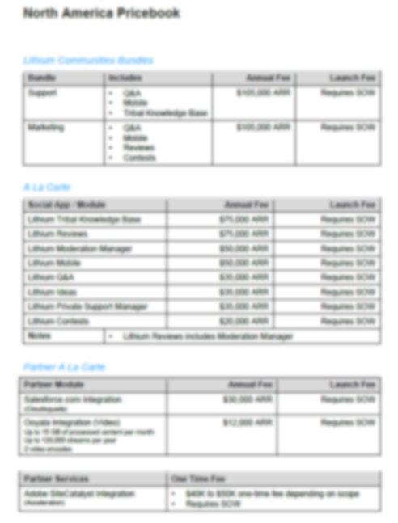
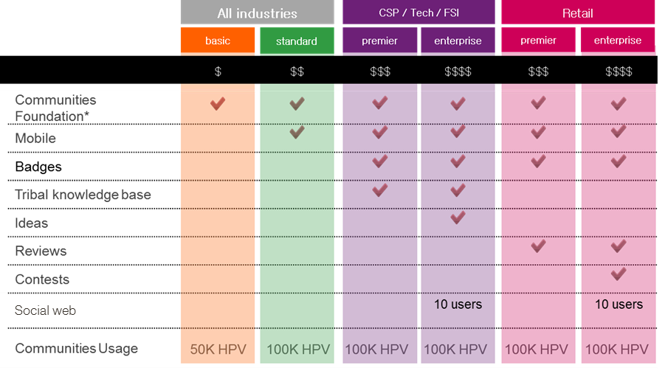
Differentiate your offering: Both for B2C as for B2B
1
Price strategy
Project example
Pre project: Long list of functionalities
Post project: Clear portfolio with upsell potential
Long list of modules and items
No clear onboarding or upselling strategy
Difficult for customers to self select
Simplifying the selection process for customers
Structure used by sales to force trade-off
Encourage upsell in negotiations with customers
Source: Simon-Kucher

Slide 11
Pricing is a process from determining the price strategy, setting the price to finally implementing it
Price Strategy
Set the right direction
Price Setting
Know the price you deserve
Price Implementation
Ensure you get what you deserve
Topics:
Strategic pricing objectives
Market and customer strategy
Optimizing the product portfolio and value proposition
Topics:
Optimizing the price structure and metrics, incl. bundling
Price setting methods based on value, competition and cost
Optimizing the price levels via price differentiation
Topics:
Discounting methods, incl. trade terms and peer pricing
Behavioral pricing
Price organization, reporting, training and incentives
Source: Simon-Kucher

Slide 12
There are different ways to set the price, ranging from a static price to continuous dynamic price setting
2
Price setting
Dynamic pricing
Variable price adjustment
  Continuous dynamic price setting, typically accounting for:
Demand vs. supply
Competitor prices
Web conversion
Stock availability
Other external factors, such as weather
Differentiated pricing
Variable price adjustment based on fixed factors typically including time, capacity or ordering behavior
Fixed pricing
Systematic price differentiation typically based on customer size/type, region or ordering behavior
Static price of products across all demand/ supply situations, customer sizes/types and regions
Most companies are here
Source: Simon-Kucher
Notes:
29

Slide 13
To determine prices, three different methodologies can be used
2
Price setting
Value-based pricing is the most recommended because it captures perceived value and drives innovation
Cost-plus
Competition-oriented
Value-based
Production costs as the starting point of the price
Prices of comparable competitors serve as reference
Prices set according
to value to customer
€150
% mark up
Competitor A
Costs
Our product
€100
Competitor B
Competitor C
€50
Most recommended pricing approach
Most chosen pricing approach
Source: Simon-Kucher

Slide 14

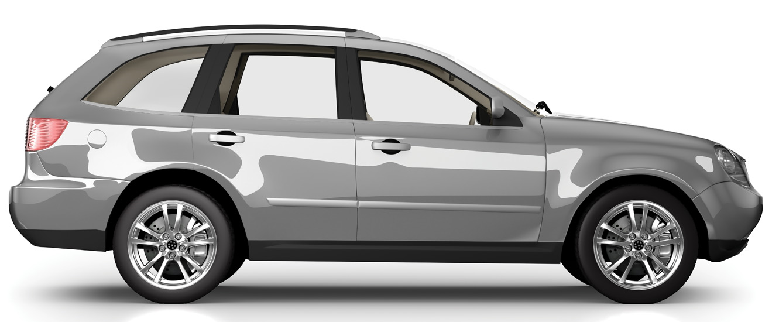
Issue with cost-plus pricing
2
Price setting
Non-metallic paint
Power/Value Pricing
Willingness-to-pay
1200 €
COLOURBOX/-
Profit potential
Metallic paint
Cost-Plus
Cost
20 €
iStock/Henrik5000
If the automotive industry sets prices according to the cost-plus approach, metallic paint would cost 30 Euro –
but the automotive industry does not!
Source: Simon-Kucher

Slide 15
Van Westendorp analysis is a scientific method to determine the consumer willingness-to-pay to identify optimal price points
2
Price setting
% of respondents accepting price point
Project example
Significant price threshold: Offering products above €200 will decrease demand significantly
Price (€)
Source: Simon-Kucher project database

Slide 16
Pricing is a process from determining the price strategy, setting the price to finally implementing it
Price Strategy
Set the right direction
Price Setting
Know the price you deserve
Price Implementation
Ensure you get what you deserve
Topics:
Strategic pricing objectives
Market and customer strategy
Optimizing the product portfolio and value proposition
Topics:
Optimizing the price structure and metrics, incl. bundling
Price setting methods based on value, competition and cost
Optimizing the price levels via price differentiation
Topics:
Discounting methods, incl. trade terms and peer pricing
Behavioral pricing
Price organization, reporting, training and incentives
Source: Simon-Kucher

Slide 17


Trade terms can be used to steer desired behavior from your trade partner and have defendable differences between partners
3
Price implementation
Recommended
retail prices
CONSUMER WILLINGNESS-TO-PAY
VAT
TRADE MARGIN
Gross price
UNCONDITIONAL
DISCOUNTS
CONDITIONAL DISCOUNTS
TRADE INVESTMENTS
Net price
iStock/monkeybusinessimages
Source: Simon-Kucher

Slide 18

Trade term framework should balance what the trade partner does for you and what it gets in return
3
Price implementation
Often reality
How it should be
Gross price
The customer gives:
Conditional discounts
(on- and off-invoice)
The customer gets:
Net
price
Net
price
Customer
gives
Customer gets
Net
price
Customer
gives
Customer gets
Customer
gives
Customer gets
Performance
Trade partners operate in different ways and consequently, benefit from a system that incentivizes performance along clear guidelines giving them the ability to directly influence their net prices
Source: Simon-Kucher

Slide 19
Finally, choice is not rational, therefore the offering, design and pricing should take customer psychology into account
3
Price implementation
Product & Packaging
Pricing
Sales/Communication
Compromise effect
Paradox of
choice
Anchor
effect
Price
thresholds
Power of
sorting
Endowment effect
1.99
6.99
Default
options
Pre-
selection
Decoy
product
% vs £
discounts
Panini
effect
Scarcity
effect
Source: Simon-Kucher
Notes:
29

Slide 20

Behavioral pricing – price anchoring
3
Price implementation
Option 1
Option 2
Option | Price in USD | % of people choosing option
Online | $59
Print + online | $125
Average revenue per subscriber | $80.12
Option | Price in USD | % of people choosing option
Online | $59
Print | $125
Print + online | $125
Average revenue per subscriber
16%
68%
0%
32%
84%
$114.44
Revenue
per
subscriber:
+43%
Source: Simon-Kucher
Notes:
78

Slide 21
Pricing is a process from determining the price strategy, setting the price to finally implementing it
Price Strategy
Setting the right direction
Price Setting
Price
Knowing the price you deserve
Implementation
Ensuring that you get what you deserve
Source: Simon-Kucher

Slide 22

Thank you!
GettyImages_Delmaine-Donson_1355039080

Slide 23
Confidentiality
This document has been prepared by Simon-Kucher & Partners B.V. ("Simon-Kucher") solely for the use of presenting to the VvM audience and may not be shared with or relied upon by any third party without the prior written consent of Simon-Kucher.
The information and conclusions included in this report are not to be quoted in whole or in part or otherwise referred to in any other document, nor are they to be filed with or furnished to any third party without the prior written consent of Simon-Kucher.
Amsterdam office
Infinity Building, 5th floor
Amstelveenseweg 500
1081 KL Amsterdam
The Netherlands
Tel: +31 20 75312 53

Slide 24

iStock/Galeanu-Mihai
Amsterdam office
Infinity Building, 5th floor
Amstelveenseweg 500
1081 KL Amsterdam
The Netherlands
Tel: +31 20 75312 53

